Slide 1

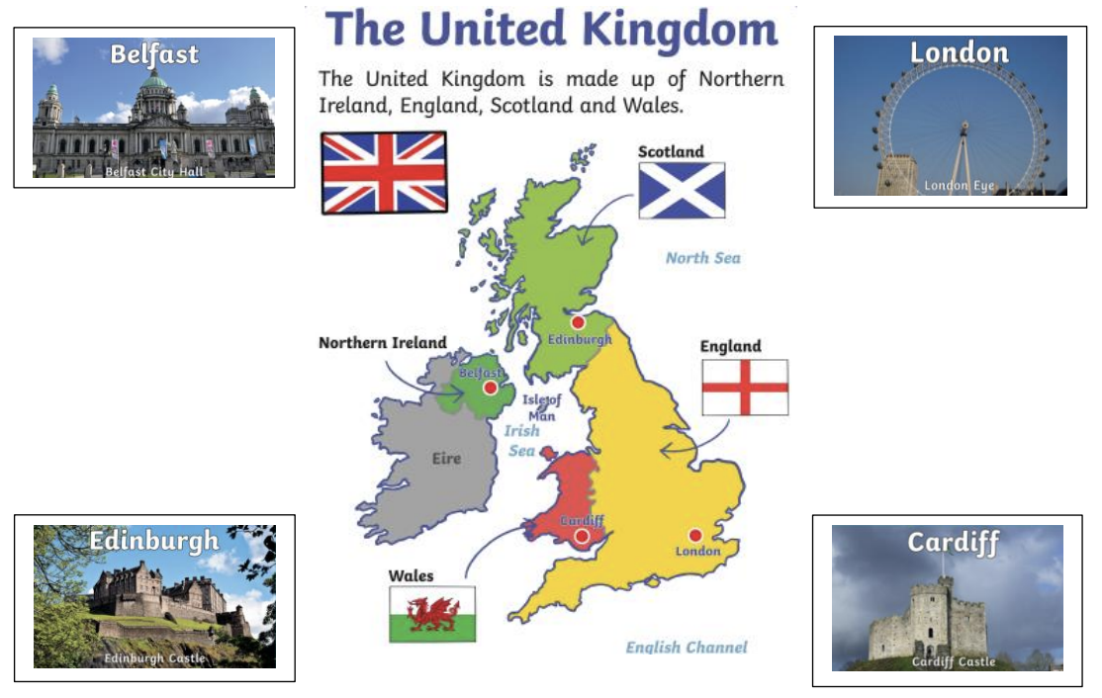
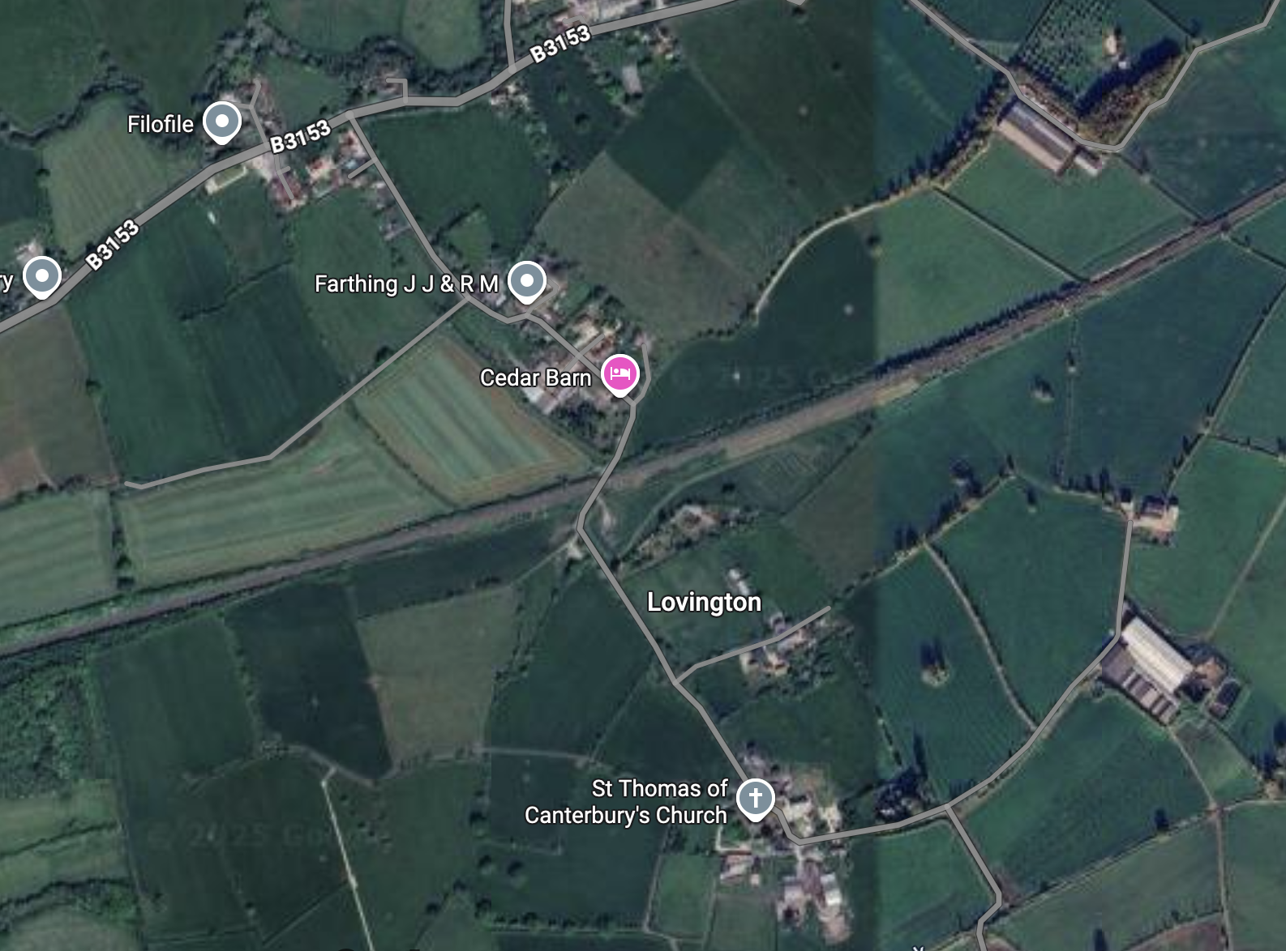
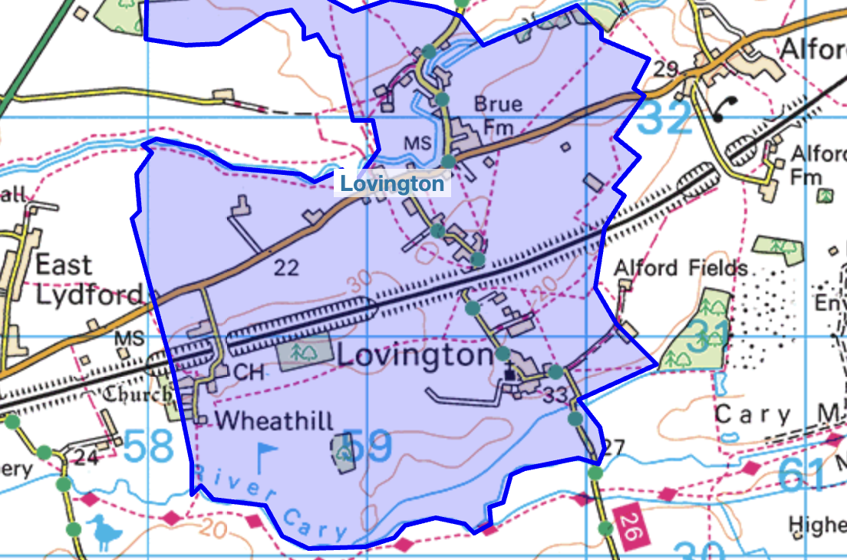
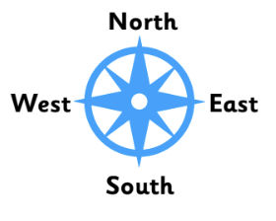
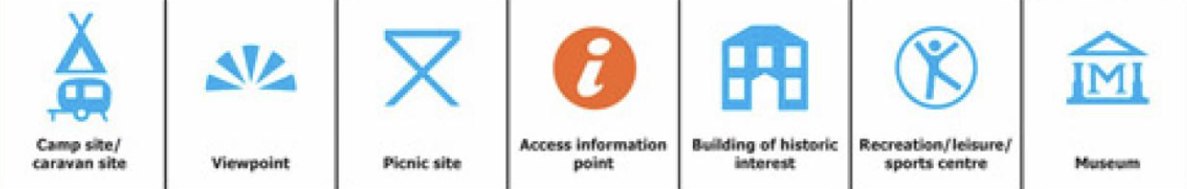
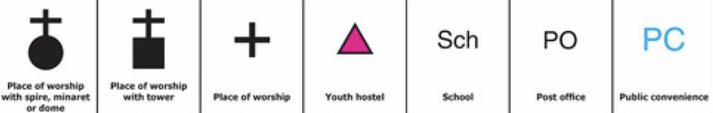
Key Vocabulary
Continent | A very large area of land with countries in them.
Capital City | A town or city where the government sits.
Sea | An area of salt water.
Union Jack | A flag made from the flags of Scotland, England, Northern Ireland and Wales.
Country | An area of land with borders that is controlled by a single government.
Town | An urban settlement with a population of between 10,000 and 100,000.
Village | A rural settlement with a population of between 500 and 3,000 people.
Atlas | A book or collection of maps that shows different regions of the world
Great Britain | England, Scotland and Wales
Geography- Pippin Class
Satelite Map
Locations and Places
OS Map
Compass Rose
We can use directional
language, including
North, East, South
and West, to direct
between two places on
a map.
We can find lots of different symbols on maps.

