Slide 1

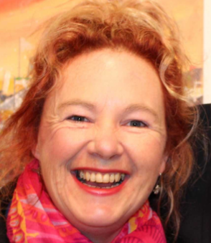
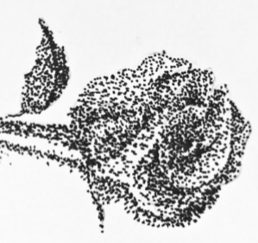
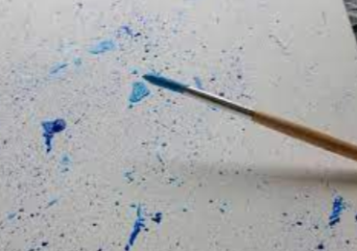
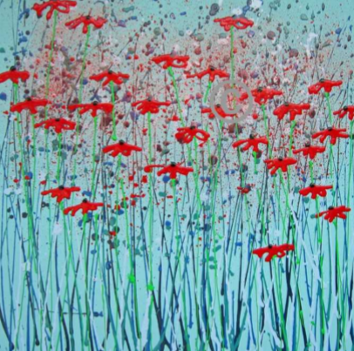
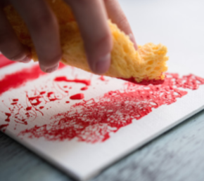
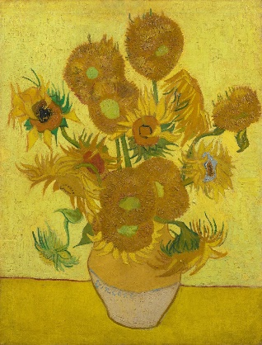
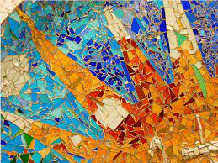
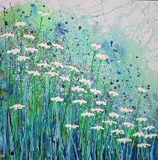
Art – Autumn 2
Key skills
Practise | Use your sketchbook to practise a range of techniques.
Plan | Plan and decide on colours, shapes and patterns.
Produce | Produce your chosen design on paper or canvas.
Evaluate | What went well? What would you change?
Display | Place your finished art work on display. Where would be the best place to display your work?
Techniques
Dry brush | Simply apply paint onto your canvas with a dry brush.
Stippling | Stippling is a drawing technique in which areas of light and shadow are created using nothing but dots.
Splattering | Spattering is a painting technique in which paint is flung, with the flick of a brush, onto the painting surface.
Washing | Washing makes your acrylic colours more translucent.
Dabbing | A dab is the motion with which you pat or apply something to a surface, and it's also the tiny amount of material you're applying.
Bubble wrap | Apply paint onto the bubble wrap and press onto paper to see the effect it creates.
Local Artist - Alce Harfield
Alce is a local artist from Somerset. She was born in Sussex in 1966 to a very creative family.
Eager to experiment, she is well known for her wild skies, seascapes, cityscapes and her first love, bright florals.
Alce is also famous for her artwork depicting Glastonbury Festival.
Famous artists
Vincent Van Gogh | Antoni Gaudí

