Slide 1

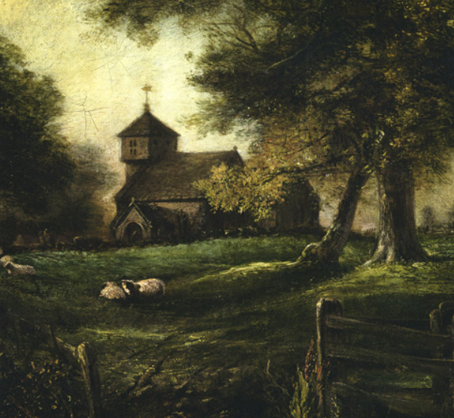
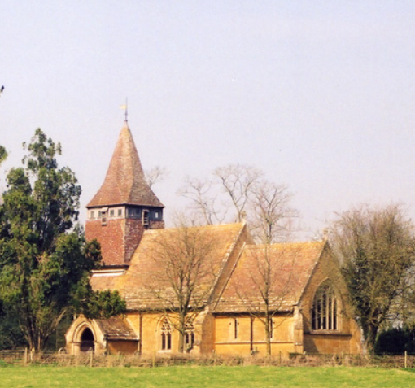
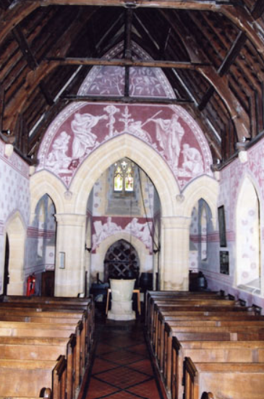
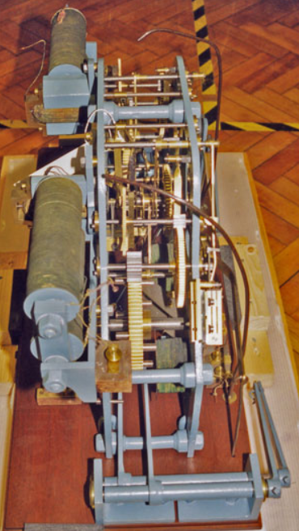
History – Autumn 2
Local Area Study
Key Vocabulary
Local History | The study of how places near where we live have changed over time.
Continuity | Something that has stayed the same over time.
Change | Something that has become different over time.
Evidence | Clues that tell us about the past, such as photos, buildings, maps or stories.
Sgraffito | Decoration made by scratching through layers of coloured plater or paint.
Medieval Period | The time between William the Conqueror’s victory at Hastings to Richard III’s defeat at the Battle of Bosworth (1066 - 1485).
Victorian Period | The time when Queen Victoria ruled Britain (1837 - 1901).
Architect | A piece of evidence or information that comes directly from the time-period or event being studied.
St Peter’s Church, Hornblotton
Key Facts Location: St Peter’s Church is in the hamlet of Hornblotton, near Lovington, Somerset. Origins: The original medieval church stood on the same site for many centuries. Rebuilding: The current church was built between 1872 and 1874, commissioned by the rector Godfrey Thring and designed by Sir Thomas Graham Jackson. Remains of the old church: A stump of the medieval tower still stands in the churchyard. Unique features: The Victorian church is famous for its sgraffito wall decoration (coloured plaster designs) and for having the first electric striking clock in England. Today: The church still serves the local community and has recently undergone conservation work to protect its historic fabric.
Medieval Period Original St Peter’s Church built in Hornblotton. | 1872 - 1874 Present church designed and built by Sir Thomas Graham Jackson | Late 1800s Church gains attention for its electric clock and sgraffito decoration. | 20th Century Changes in farming, roads and community life affect the area around the church. | 21st Century Repairs and conservation ensure the church remains part of local life.

