Slide 1

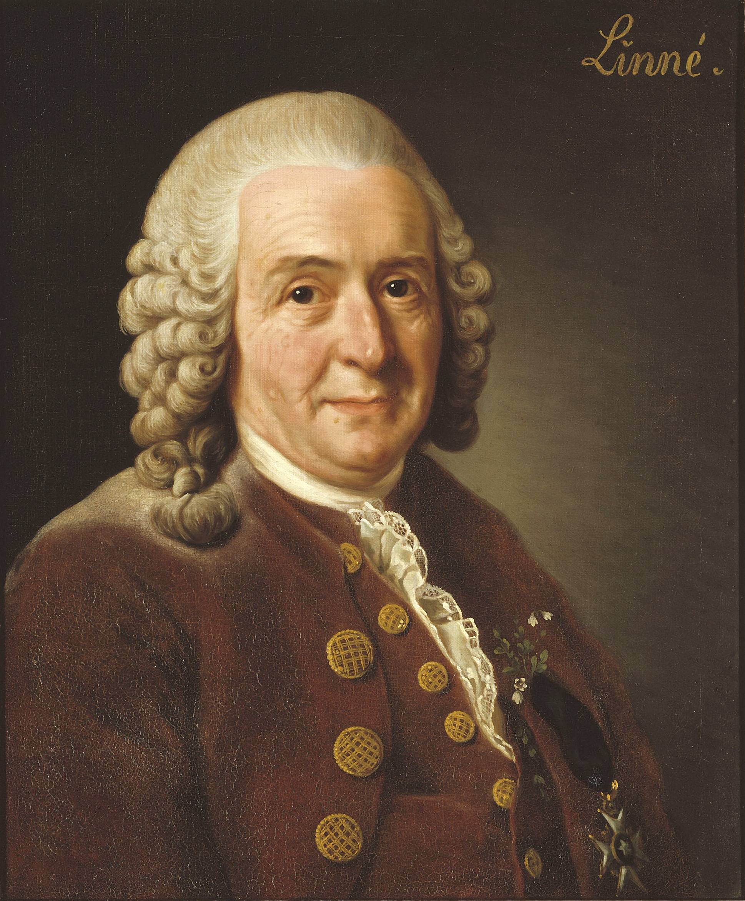
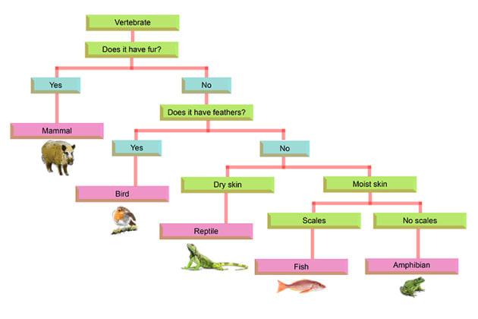
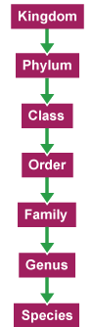
Russet - Autumn 2 - Science - Classification
Key Information
All living things can be classified into groups based on their features. Scientists use keys (branching diagrams) to identify living things. The five main groups of vertebrates: fish, amphibians, reptiles, birds, mammals. Invertebrates include insects, arachnids, molluscs, and others. Microorganisms can be helpful (yeast in bread) or harmful (bacteria causing illness). Classification helps scientists organise, name and understand living things.
Key Vocabulary
Species | A group of similar living things that can reproduce.
Vertebrate | An animal with a backbone.
Invertebrate | An animal without a backbone.
Mammal | Warm-blooded vertebrate with fur/hair that feeds its young milk.
Reptile | Cold-blooded vertebrate with dry, scaly skin.
Amphibian | Vertebrate that lives part in water and part on land.
Bird | Warm-blooded vertebrate with feathers and beak; most can fly.
Fish | Cold-blooded vertebrate that lives in water and has gills.
Microorganism | Living thing too small to see without a microscope.
Fungi | Living things like mushrooms and molds that feed on other materials.
Bacteria | Tiny microorganisms; some helpful, some harmful.
Environment | The surroundings where a living thing lives.
Adaptation | A feature that helps a living thing survive in its environment.
Key Scientists
Carl Linnaeus (1707 - 1778) developed a widely used system for naming and classifying living things. Aristotle (384 - 322 BC) was the first to consider a system to classify living things. David Attenborough (1926 - present) is a modern-day naturalist who studies living things.

