Slide 1

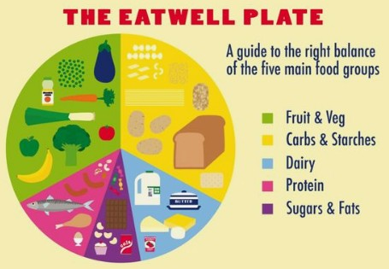
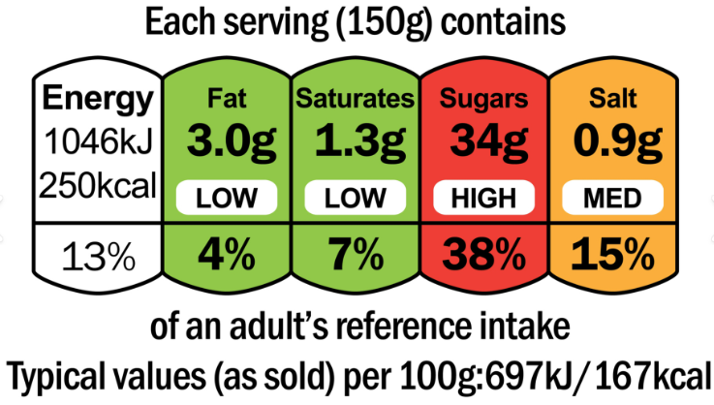
Bramley - Autumn 2 - Science
Animals (including humans)
Key Vocabulary
Nutrition | The process of taking in and using food for growth and energy.
Nutrients | Substances in food that help us stay healthy (e.g. protein, carbohydrates, vitamins).
Skeleton | The framework of bones that supports and protects the body.
Endoskeleton | An endoskeleton is a skeleton inside the body that protects organs and helps an animal to stand, move and stay upright using joints.
Exoskeleton | An exoskeleton is a hard shell that some living things have on the outside of their bodies to protect them and give them structure.
Hydrostatic skeleton | A hydrostatic skeleton is a body structure supported by fluid inside a soft body. It helps an animal keep its shape and move.
Bones | Hard parts of the skeleton that give our body shape and structure.
Muscles | Soft tissues that work with bones to help the body move.
Joints | Places where two bones meet, allowing movement.
Support | The skeleton holds the body up and gives it shape.
Protection | The skeleton protects important organs (e.g. the skull protects the brain).
Movement | Muscles pull on bones to help us move.
Vertebrate | An animal with a backbone (e.g. humans, birds, fish).
Invertebrate | An animal without a backbone (e.g. worm, snail, insect).
Key Information
Animals, including humans, need the right types and amounts of nutrition. Animals cannot make their own food - they get nutrition from what they eat. Humans and some other animals have skeletons and muscles for support, protection and movement.
A Balanced Diet
Carbohydrates | Give us energy.
Protein | Helps the body to grow, repair itself and build strong muscles..
Minerals | Help us to grow and stay healthy.
Vitamins | Help with growth and development.
Fats | Provide energy and help the body to absorb some vitamins.
Key Scientists
Jane Goodall (1934 - 2025) was a British scientist who has studied chimpanzees for many years. She is considered to be the world expert on chimpanzee behaviour. David Attenborough (1926 - present) is a modern-day naturalist who studies living things.

