Slide 1

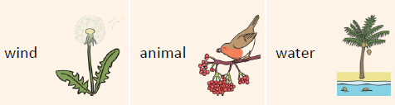
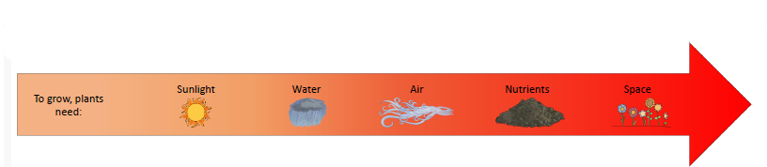
Science – Bramley
Spring 2 - Plants
Key Vocabulary
Life cycle | Flowering plant’s life cycles start with a seed
Photosynthesis | How plants use light and air to make energy.
Pollen | Insects or the wind carry pollen between flowers.
Seed formation | Once flowers have been pollinated, the plant forms a seed.
Seed dispersal | Seeds from a plant are spread around to make sure they have space to grow,
Parts of a Plant
Flower | Attracts insects for pollination
Stem | Transports water and nutrients around the plant.
Leaves | Collect sunlight and oxygen for photosynthesis
Roots | Take in water and nutrients from the soil.
Plant Lifecycles
Plants use flowers to attract insects for pollination.
Insects, like bees and butterflies, visit flowers because of their bright petals, sweet smell and nectar to drink.
Seeds can be dispersed in different ways:
Working Scientifically
We can investigate how water travels in plants by setting up an experiment.

