Slide 1
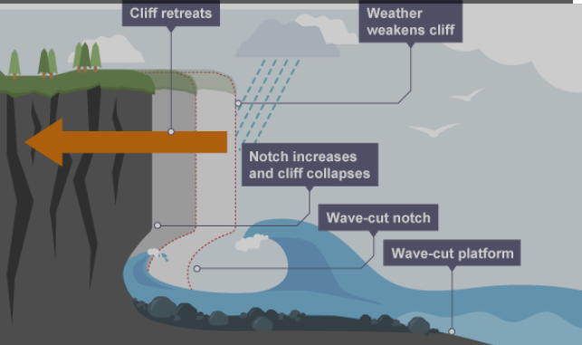
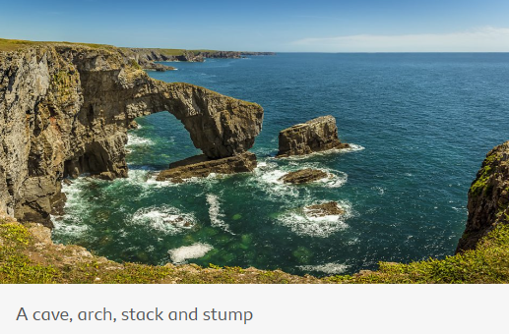

Key Knowledge
What are coasts? | Coasts are where the land meets the ocean. This can take different forms such as beach and cliffs.
How are coastal landforms formed? | The sea’s waves lead to hydraulic action and erosions of the land. The land is made up of different rocks, some hard, some soft, leading to bays and headlands. Further erosion leads to cracks, caves, arches, stacks and stumps.
Ocean processes | Waves are created by the movement of air across the sea. Tides are created by the gravitational pull of the moon.
Key Vocabulary
Coast | The area where the land and sea meet.
Beach | A low-lying area where the land meets the sea, made up of fine, lose sediment.
Cliff | A high-altitude area where the land meets the sea, made of hard rock.
Erosion | The process where material is removed from the land.
Headland | An area of land protruding into the sea.
Bay | An area of sea protruding into the land.
Longshore drift | The process through which sediment is moved across the beach.
Hydraulic action | The weight of a wave crashing on a cliff face, pushing the air in cracks and caves, under pressure, to force it open.
Geography - Coastal Features
Summer 1
Diagram and Photograph
Caves Arches Stacks Stumps

