Slide 1

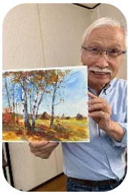
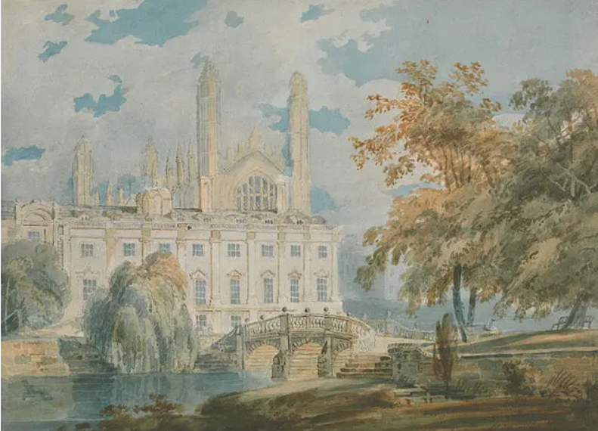
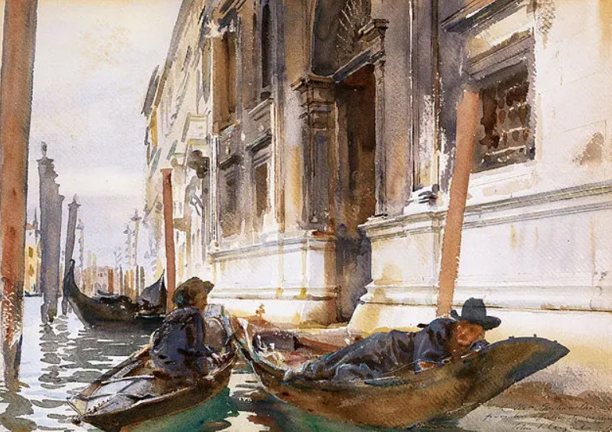
Art – Summer 1
Key Vocabulary
Tone | The lightness or darkness.
Blend | Mixing colours into each other.
Layer | Building colours or textures on top of each other.
Gradient | A gradual change.
Primary colours | Red, blue and yellow
Secondary colours | Violet, orange and green
Tertiary colours | Yellow-orange, red-orange, red-violet, blue-violet, blue-green and yellow-green.
Warm | Reds, oranges and yellows.
Cool | Blues, purples and greens.
Foreground | The front of the painting.
Middle ground | The middle of the painting.
Background | The back of the painting.
Horizon | Where the sky meets land or sea.
Techniques
Wet-on-wet | Applying wet paint onto wet paper or a wet layer of paint, allowing for blending and soft edges.
Wet-on-dry | Applying wet paints onto dry paper or a dry layer of paint, allowing for sharper edges, controlled layering and detailed work.
Colour washing | Applying a smooth, even layer of diluted paint to create backgrounds, gradients or layered effects.
Dry brushing | Using a brush with minimal water and paint, allowing for broken, streaky strokes that enhance the artwork’s depth and texture.
Dabbing | Applying paint using a repetitive vertical hand motion, creating a soft, airy texture.
Lifting | Removing paint using a clean, slightly damp brush or sponge to correct mistakes, create highlights or add texture.
Harumichi Shibasaki
Shibasaki is a Japanese watercolour artist who focuses on nature in his pieces. He mainly paints calm landscapes using soft blending and layering. He is a teacher with a background in art education. He has taught people to paint for over 50 years.
Famous watercolour artists
J.M.W. Turner | John Singer Sargent

