Slide 1
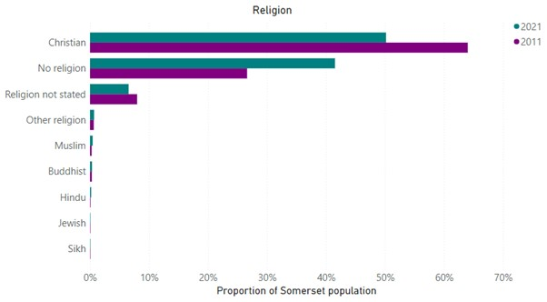
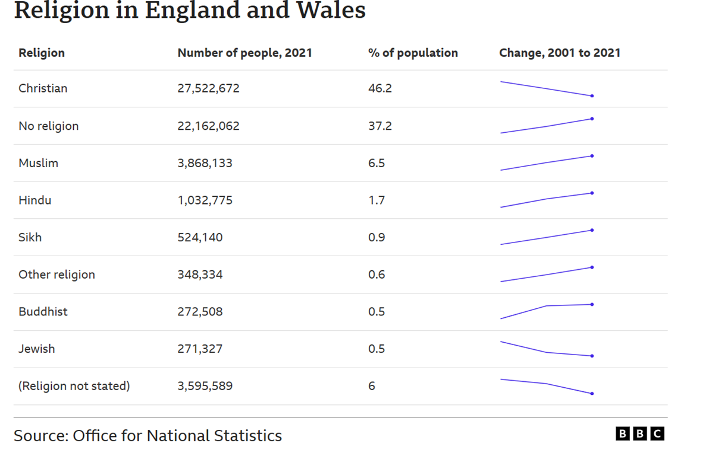
1. Key words
Russet – Summer Term
Religion | The belief in a god or group of gods.
Worldview | Describes the way in which a person encounters, interprets, understands and engages with the world.
Social sciences | The study of human society.
Philosophy | The study of ideas about knowledge, truth, the nature and meaning of life.
Theology | The systematic study of the nature of the divine, God and religious beliefs, as well as their relationship to the world and humanity.
Monotheism | The belief in the existence of one God.
Muslim | A follower of the Islamic religion.
Islam | A major world religion that emphasises monotheism, the unity of God ( Allah in Arabic).
Mosque | A place of Muslim worship.
Christian | A follower of Jesus Christ. Someone who believes in Jesus as the Son of God and Saviour and seeks to follow His teachings.
Census data | An official count of a population and the collection of related information, typically for a country or region, at a specific time.
Community | A group of people who live in the same place or share the same beliefs.
Trend | A general direction or tendency in the way something is developing or changing.
Interpretation | The explanation of something, often a religious text or concept.
Locality | A particular place or area.
2. What does the census data show us about religion and worldviews in Somerset?
How does data help us understand religion and worldviews in Somerset?
That less people describe themselves as a Christian in 2021 than 2011.
That more people did not state their religion in 2021 than in 2011.
That when we compare data for Somerset with England and Wales, there are some similar trends.

