Slide 1

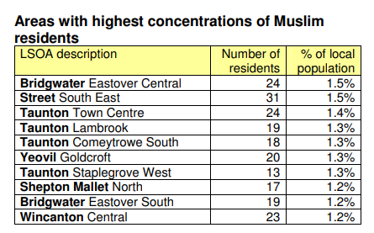
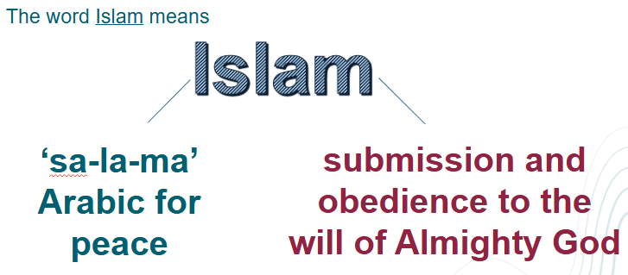
1. Key words
Bramley – Summer Term
Allah​ | The Arabic word for God in Islam.​
Tawhid​ | The belief in the oneness of Allah. It is acknowledged in the First Pillar of Islam: There is no god but God.​
Islam​ | The religion of Muslims.​
Muslim​ | A follower of Islam.​
Qur'an​ | The holy book of Islam.​
Muhammad​ | The last and most important prophet in Islam.​
Prophet​ | A person believed to be a messenger of God.​
Makka (Mecca)​ | The holiest city in Islam, located in Saudi Arabia.​
Hadith ​ | Books that contain accounts of the Prophet's sayings, actions, and approvals, offering insights into his life and character. Hadith are considered a vital source of religious law and moral guidance, second only to the Qur'an. ​
Ablution: wudu​ | Ritual washing before prayer. ​
Zakat​ | The giving of charity to the needy. The third pillar of Islam. ​
Salah​ | Ritual prayer five times a day. The second pillar of Islam.​
Imam​ | A leader of prayer in a mosque.​
Mosque​ | A place of Muslim worship.​
Submission | the action of accepting or yielding to a superior force or to the will or authority of another person.
2. What are the proportions of worldviews in Somerset?
Only 0.6% of the population of Somerset identify as Muslim.
SUBMISSION
Muslims believe in one God, called Allah
Islam means submission to God
Muslims show submission through beliefs, practices, and actions
Belief affects how Muslims live their daily lives
People can understand religious ideas in different ways
How do different Muslims in Somerset show submission?
Notes:
Please note that you might not want to include all of these definitions in the knowledge organiser shared with pupils. Please adapt this to meet the needs of your class and how Knowledge Organisers are used in other subjects across your curriculum.

Slide 2
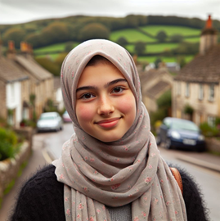
Key Beliefs in Islam (Theology)
Belonging and Community in Islam (Social Science)
One God- Allah | Muslims believe there is one God – this belief is called Tawhid The Qur’an is the holy book of Islam Muslims believe the Qur’an teaches them how to live. Submission means choosing to follow God’s guidance. A theologian studies religious texts to understand what they teach
The Shahada | The Shahada (Statement of Faith) “There is no god but Allah, and Muhammad is the Messenger of Allah.” This shows belief and commitment.
Prayer (Salah) | Muslims pray five times a day Before prayer, they wash (called Wudu) Prayer helps Muslims remember God and focus
Quaran | Muslims believe the Qur’an is God’s special book that shows Muslims how to live. Muslims believe in angels, prophets, and that people will be judged by God at the end of life, as taught in the Quran.
Five Pillars of Islam | Shahada (faith), Salah (prayer), Zakat (charity), Sawm (fasting in Ramadan), and Hajj (pilgrimage).
Community | Humans need to belong. Mosques help Muslims feel part of a community. Children may go to Madrassah to learn about Islam. Being with others helps Muslims live out their beliefs
Mosque | A mosque is a place of worship. The Imam leads prayers. The Adhan is the call to prayer The Minbar is where sermons are given Mosques bring Muslims together as a community
Charity and Helping Others | Zakat is giving money to help people in need It is one of the Five Pillars of Islam Giving money shows kindness, sacrifice, and submission Muslim charities help people locally and around the world
UK/Somerset | Most British Muslims feel they can freely practise their faith in the UK. Many see their religion as an important part of who they are as people. They also want good relations with people from other religions and communities in Britain.
How do different Muslims in Somerset show submission?
Big Questions (Philosophy).
Actions v words | Is it better to say you believe or to show it through actions? Can people have different views about the same belief? How do my own beliefs affect the way I live? Many Muslims believe that actions matter, not just words.
What do Muslims believe about Muhammad (Peace Be Upon Him)?
Muslims believe that Muhammad was a prophet of God. A prophet is someone chosen by God to share God’s message with people. Muslims believe Muhammad was the last prophet sent by God. Muslims respect Muhammad very much, but do not worship him. They believe he showed people how to live a good life by his words and actions.
The Qur’an and Muhammad
Muslims believe the Qur’an is the holy book of Islam. They believe the words of the Qur’an came from God (Allah). Muslims believe the Qur’an was revealed to Muhammad. Muhammad did not write the Qur’an himself. Muslims believe the Qur’an was written down by Muhammad’s followers as he recited God’s words.

