Slide 1



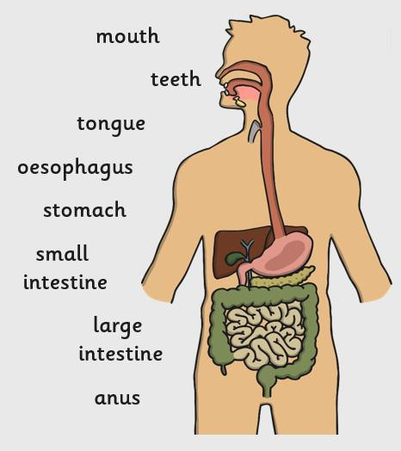


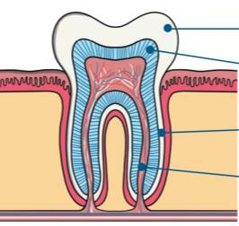





 |  |  |  |  | Key Vocabulary |  | 🗸
 |  |  |  |  | food chain | A series of organisms dependent on the next as a source of food.
Human Teeth |  |  | 🗸
We have different types of teeth that do different jobs: |  |  |  |  | organisms | Living things including plants and animals.
Incisors : Used for biting and cutting food | Molars: Grinding food
 |  |  |  |  | dependent | If you are dependent on something, then you need it to survive.
Premolars: Holding and crushing food | Canines: Used for tearing and ripping food
 |  |  |  |  | producer | An organism that can produce its own food.
enamel Teeth are made up of different parts ^{dentine} that have different functions. ^{cementum} pulp
 |  |  |  |  | consumer | An organism that eats another organism to get energy.
 |  |  |  |  | prey | An animal that is hunted by another animal.
Links to Real Life
If we understand our digestive system, we can make sure we are keeping ourselves healthy. |  | Using food chains helps us see how animals in different habitats depend on each other so that we can look after them. |  |  | predator | An animal that hunts other animals for food.
Science – Years 3 and 5
Teeth – Summer 1
The Digestive System | 🗸
The different parts of our digestive system do different jobs.
Food Chains:
producer
consumers

