Slide 1


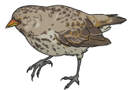
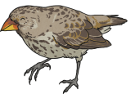


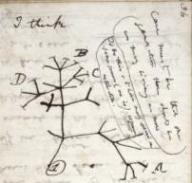
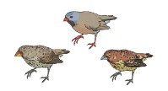
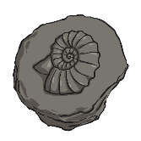

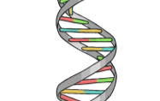
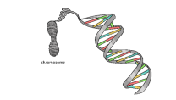
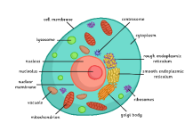
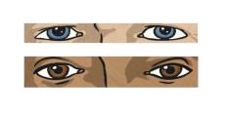
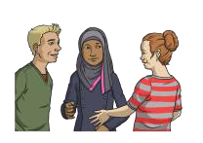
Science – Years 5 and 6
Evolution and Inheritance
Summer 1
Key Vocabulary |  | 🗸
DNA | The information inside our cells which determines our features.
Genes | Sections of DNA responsible for certain traits and characteristics.
Offspring | Organisms which are genetically related to their parents (or ancestors).
Inherited | Passed down to offspring through DNA.
Adaptation | A variation in an organisms characteristics which helps them survive in their habitat.
Species | A certain type of organism. Animals of the same species share lots of the same DNA.
Evolution | The way living things adapt to their environment over time.
Inheritance | 🗸
Our DNA is the information in our cells that determines our features.
This genetic information is passed down from our parents.
Because they get DNA from both parents, offspring are different from their parents and each other.
Sometimes DNA is accidentally changed, making individuals unique.
Sometimes these inherited characteristics make an organism more likely to survive, and so this adaptation gets passed onto more offspring.
Theory of Evolution |  | 🗸
Charles Darwin was a biologist who travelled around the world studying the differences and similarities between different species.
He studied finches in the Galapagos islands and noticed that the finches on each island were adapted to eat the different food in each place.
He wrote down his ideas and called it “The Theory of Evolution”.
This theory explains how animals and plants adapt to the habitats they live in over time, because genetic changes are inherited.
Being a Scientist
We use observations of things that are alive, and historical evidence like fossils, to support our ideas about evolution.
Darwin believed all living things had a common ancestor.
Whole
Organisms
Genes
DNA
Cells
Characteristics

